Slide 1
AN EXPLORATION OF ORGANIZATIONAL LEVEL INFORMATION SYSTEMS DISCONTINUANCE INTENTIONS
FOR FUN
M11123046 周子懷 M11123038 曾治程M11123016 陳秉言 M11123039 廖顯億 M11123052 賴俊佑 M11123062 陳靖穎

Slide 2
AGENDA
1.
1.
2.
2.
3.
3.
Introduction
Theoretical Framing
Qualitative Exploration

Slide 3
Introduction
01
Background、Motivation、Purpose

Slide 4
Background
The organizational salience of inadequate attention to discontinuance is underscored by the significant implications.
Only 4 articles gave attention to the final stages of the IS life cycle within seven leading MIS journals over the past 20 years.
The organizations are placed in a constant tension between the need to maximize the value extracted from existing system investments and the need to discontinue the use of systems that are no longer appropriate to their need
1

Slide 5
Motivation
To provides a foundation for future discontinuance research as well as valuable guidance to organizations seeking to maximize the value obtained from their IS investments.
We are interested in developing an understanding of what drives organizational level IS discontinuance decisions.
2

Slide 6
Purpose
What factors lead to the emergence of organizational intentions to discontinue the use of an existing information system?
3

Slide 7
Theoretical Framing
02

Slide 8
Theoretical Framing
The nature of IS discontinuance suggests that it is a form of intentionally driven.
Salient among this work is the TOE framework
Technology
Organization
Environment
While we acknowledge that such interactions are possible, our primary purpose at this stage was to identify the key direct effects.
4

Slide 9
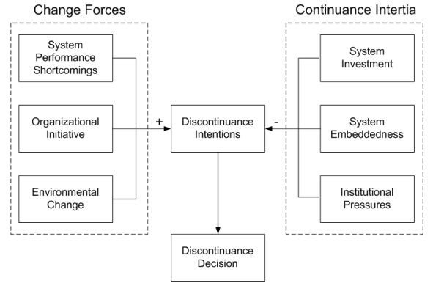
5

Slide 10
Change Forces
Three key classes of change drivers.
Life cycle based forces
Teleological forces
Evolutionary forces
6

Slide 11
System Performance Shortcomings
Defined as the extent to which a system consistently and effectively accomplishes the tasks that it is expected to accomplish.
Performance-oriented forces have been identified as important drivers of end-of-life decision making
Performance can be negatively impacted by intrinsic characteristics of the software and aging hardware.
Such performance was identified as the key life cycle force in our a priori framework.
7

Slide 12
Organizational Initiative
Defined as internal organizational effort directed toward altering where and how an organization operates.
A teleological perspective that sees goal-directed behavior and strategic choice.
The changes in the strategic vision of an organization, rather than strictly technical issues, are increasingly driving the need to discontinue the use of information systems.
8

Slide 13
Environmental Change
Defined as change in the physical or social factors that lie outside of the boundaries of an organization.
Environmental change is seen as accounting for evolutionary based change in our a priori framework.
Environmental changes have been identified in the literature as contributing to the need for organizational change.
Government regulations and the emergence of new and distinctive competitive threats.
9

Slide 14
Continuance Inertia
Led to：
The identification of the level of financial and other investments in an existing system.
The degree of embeddedness of this system within organizational activities.
The institutional pressures from the organization’s environment.
10

Slide 15
System Investment
Sunk cost effect：
The tendency of decision makers to continue making resource commitments to an endeavor once an initial commitment of resources has been made.
Reputation effects：
The discontinuance of a system that has consumed considerable organizational resources can also threaten them reputation.
Switching costs：
The investments in the implementation and operation of an existing system.
11

Slide 16
System Embeddedness
The extent to which the use of an information system is an integral part of organizational activity.
The nature of the organizational routines that often surround information systems.
The extent to which a system is linked to other information systems both within an organization and across organizational boundaries can vary such that some systems are more tightly integrated than others.
12

Slide 17
Institutional Pressures
The three key pressures that can lead organizations to conform to the practices of other organizations：
Coercive
Normative
Mimetic pressures
13

Slide 18
03
Qualitative Exploration

Slide 19
Qualitative Exploration
Data for this stage of the research was collected via semi- structured interviews conducted with senior decision makers who were sufficiently familiar with organizational IS discontinuance to adequately discuss the subject in an inter- view session.
14

Slide 20
Data Analysis
Analysis of interview transcripts was guided by grounded theory techniques.
The objective was to assess codes and relationships in light of the understanding gained during data analysis and to ensure that these codes and relationships continued to reflect the spirit of informant remarks.
15

Slide 21
Qualitative Exploration: Results and Hypothesis Development
What factors lead to the emergence of organizational intentions to replace an existing information system?
Particular interest was in understanding what drives and constrains the emergence of plans or intentions to replace an existing system.
16

Slide 22
System Performance Shortcomings
System Capability Shortcomings
A limitation in the functionality of an information system that undermines its ability to meet organizational needs.
System capability shortcomings were frequently framed in reference to organizational needs or requirements.
17

Slide 23
System Performance Shortcomings
System Reliability
The extent to which a system can be counted on to perform its intended tasks.
The continued use of systems that were becoming unreliable was widely regarded as presenting excessive risk to the business.
18

Slide 24
Environmental Change
System Support Availability
The availability of the vendor and other support capabilities considered important to the continued use of an information system.
The reduced availability of individuals with the requisite expertise.
Vendor decisions to discontinue product support.
Concern surrounding the ability to obtain replacement parts for the hardware upon which a system runs.
19

Slide 25
Environmental Change
System Support Cost
The costs that an organization incurs to support ongoing operation of an information system.
Excessive support costs can lead to an increased interest in replacing an existing system even when support remains readily available.
20

Slide 26
System Investment
The financial and other resources committed to the acquisition, implementation, and use of an information system.
Avoid “wasting” investments in existing systems.
initial capital investments in a system
past commitments of time
other resources to support and maintain the system
investments made in training IT staff and system users
21

Slide 27
System Embeddedness
The extent to which an information system relies on sophisticated linkages among component elements to deliver needed capabilities.
The Replacement intentions were formed more easily for systems with only limited technical integration when compared to those characterized by extensive, complex integration.
22

Slide 28
Q & A

